Slide 1
SMART PARKING

Slide 2
INTRODUCTION
Smart Parking technology is used to help drivers find parking spaces efficiently.
IR Sensors in parking spots detect whether they are occupied or available.
This information is then transmitted over the internet to apps or devices that drivers can access, such as smartphones or in-car navigation systems.
This reduces the time spent searching for parking, helps with traffic management, and can include features like parking monitoring, guidance, and reservations.

Slide 3
Components Used: ESP 32 Wifi Module, IR Sensors, LEDs
Software: Arduino IDE
Language Used: Embedded C
DataBase: Firebase
App FrameWork: Blynk App, MIT Inventor App, Streamlit WebApp

Slide 4
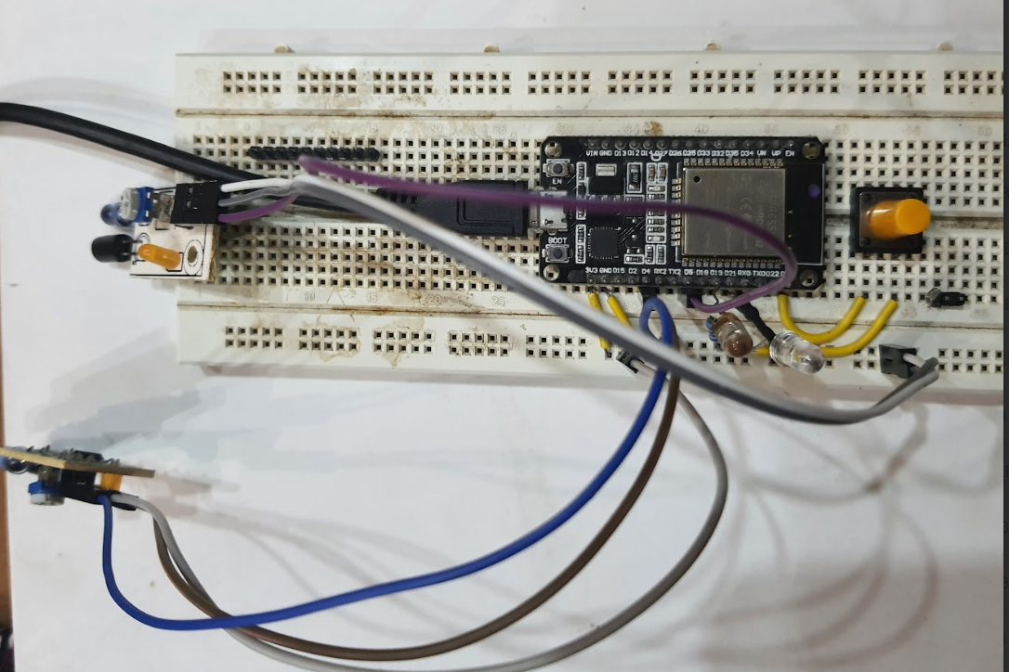
Hardware Setup

Slide 5
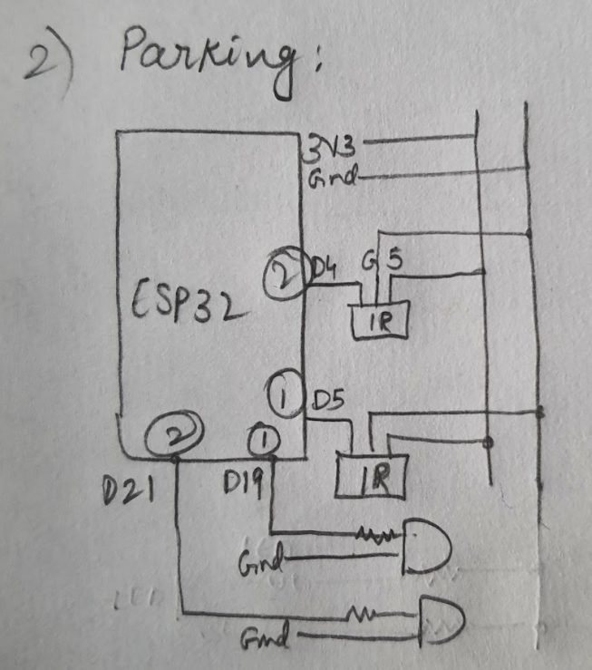
Hardware Setup

Slide 6
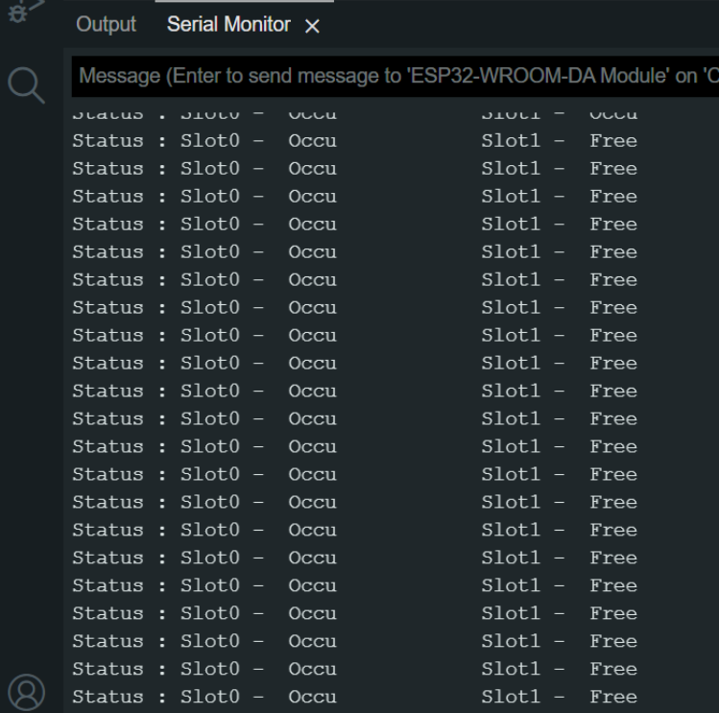
Arduino IDE

Slide 7
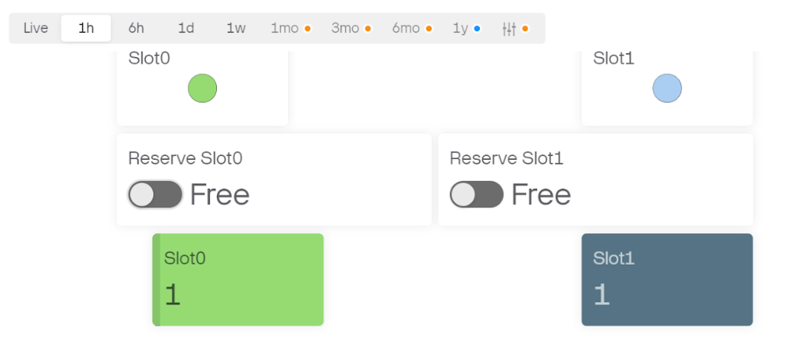
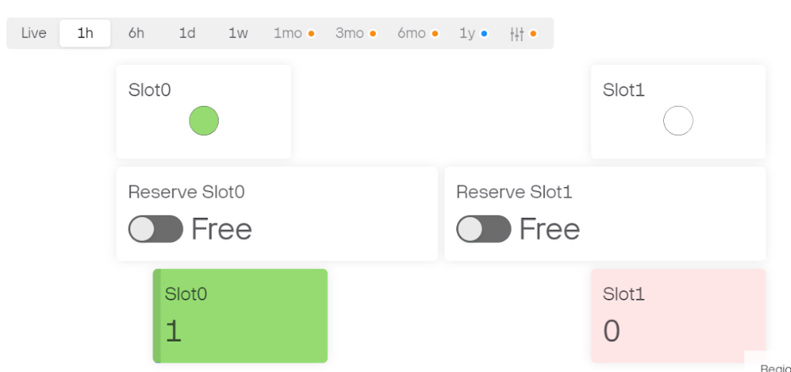
Blynk Dashboard

Slide 8
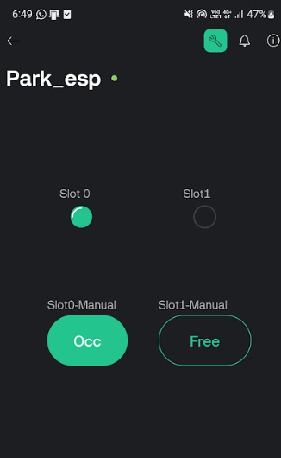
Blynk App

Slide 9
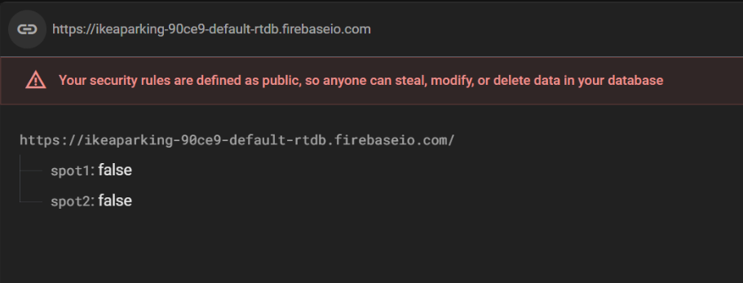
Firebase Database

Slide 10
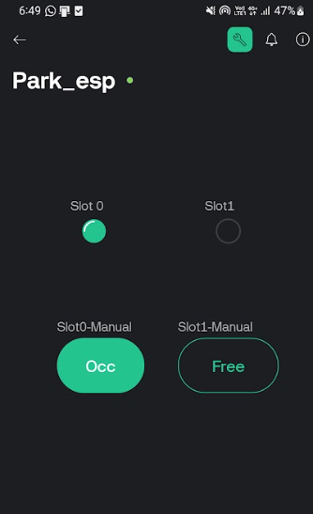
Blynk App

Slide 11
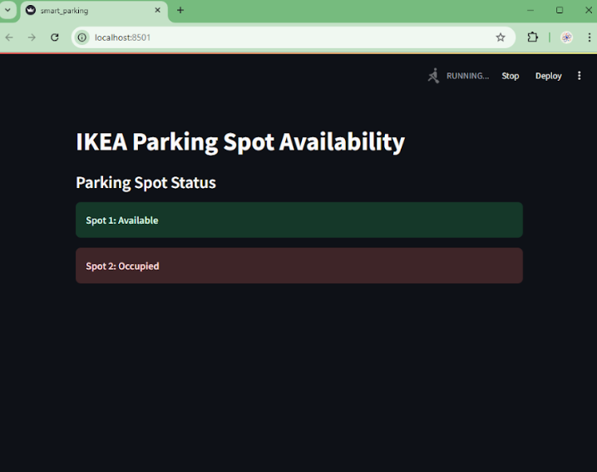
Streamlit WebApp

Slide 12
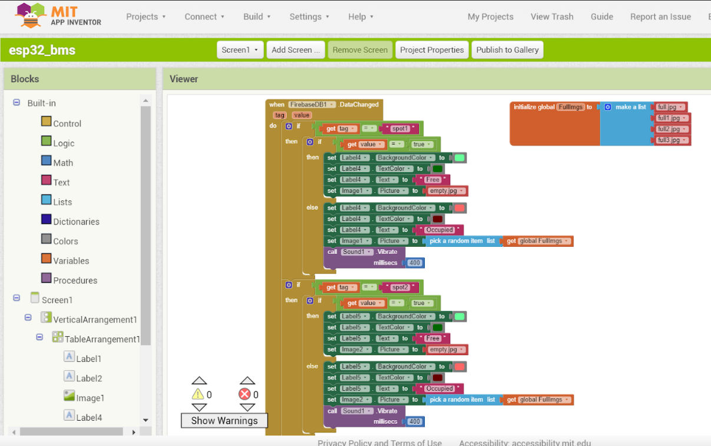
MIT INVENTOR APP

Slide 13
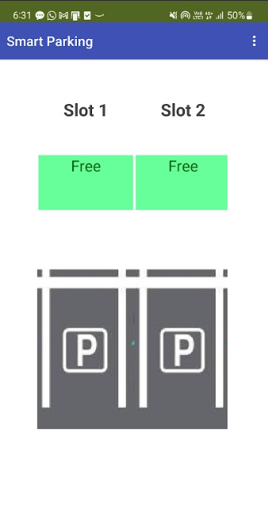
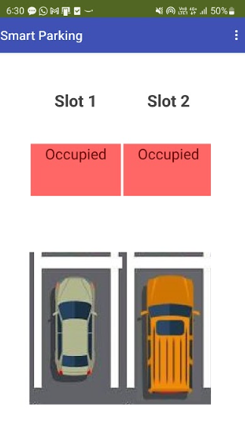
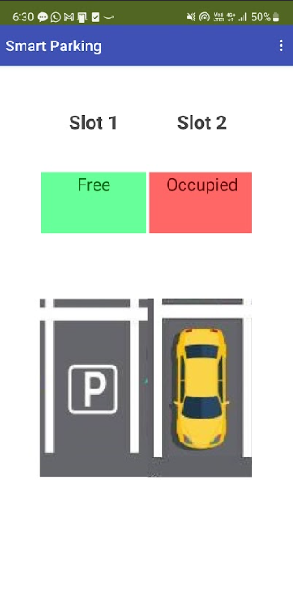
MIT INVENTOR APP

Slide 14
VIDEO LINK
https://drive.google.com/file/d/1ynn8wt6CtIFKvwo4OrJq2JWmB1GdNkPs/view?usp=drive_link

Slide 15
APPLICATIONS
Real-time Parking Availability Monitoring: Smart parking systems use sensors to monitor the occupancy of parking spaces in real time. This information can be displayed through mobile apps or digital signage, allowing drivers to find available spots quickly.
Reservation Systems: Users can reserve parking spaces in advance through apps, ensuring they have a guaranteed spot upon arrival, which is especially useful in busy urban areas or during events.
Navigation Assistance: Smart parking apps can guide users to the nearest available parking spot, utilizing GPS and mapping technologies. Some systems can even direct users to specific parking spaces within larger lots.
Integration with IoT Devices: Smart parking solutions can be integrated with other IoT devices, such as traffic management systems, to optimize overall urban mobility. This can help reduce traffic congestion and improve air quality.

Slide 16
THANK YOU

